Slide 1
Excel final assessment
Sivaganes K C - 4312

Slide 2
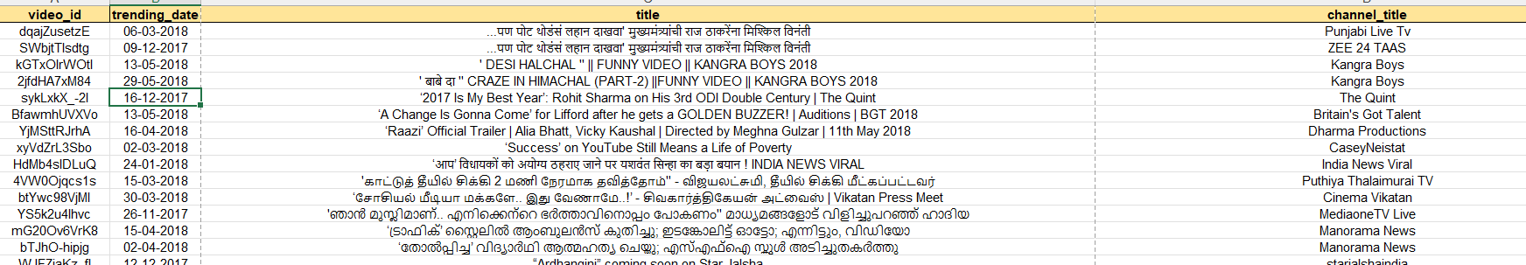
Question 1
Observation
Data in the initial table was filtered
Publish_date and trending_date were not formatted
All the data are unique, even the same titled videos have different channel names
Sample snippet:
Steps
Select the publish_date and trending_date and click number format and format it as date(DD:MM:YYYY)
Count the null values using COUNTBLANK()
Remove the duplicates by selecting the table and clicking the remove date duplicates in data tools
Insights
There are ZERO null values
Duplicates were also ZERO

Slide 3
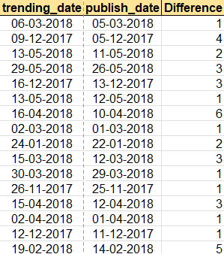
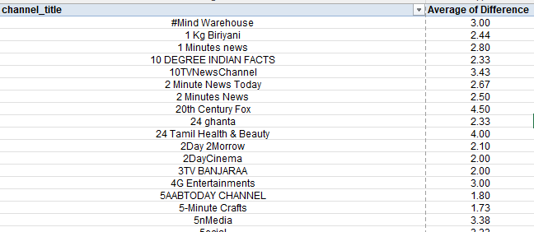
Question 2
Insights
In general ,it takes average of 2.3 days for a video to get trend
Channel named Wrestling Reality’s average tops at 0 days
Steps
Calculate the time difference by subtracting trending_date and Publish_date
Create pivot table and find the average and top channels which takes lesser days to trend
Formula
Used PIVOT TABLE

Slide 4
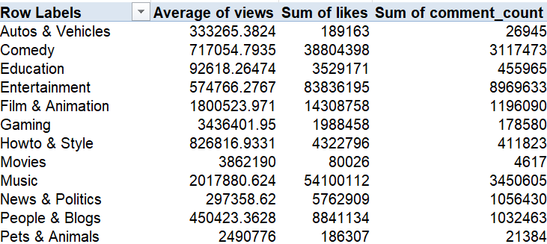
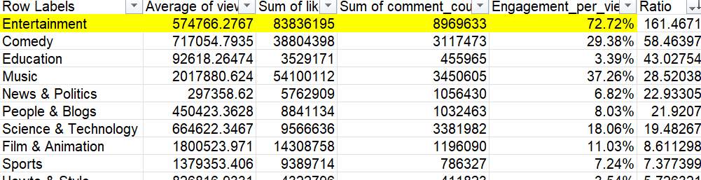
Question 3
Insights
Entertainment category has the highest average number of views and engagement rate
Steps
Find category name using xlookup
Then calculate the engagement rate
Finally look for the ratio
Formula
xlookup category | =XLOOKUP(E2,Category!$A$1:$A$33,Category!$B$1:$B$33,"n/a")
Engagement | =(H4/$H$21)+(I4/$I$21)
Ratio | =(H4+I4)/G4

Slide 5
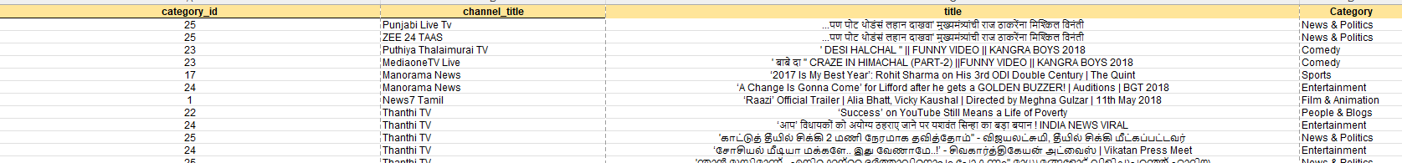
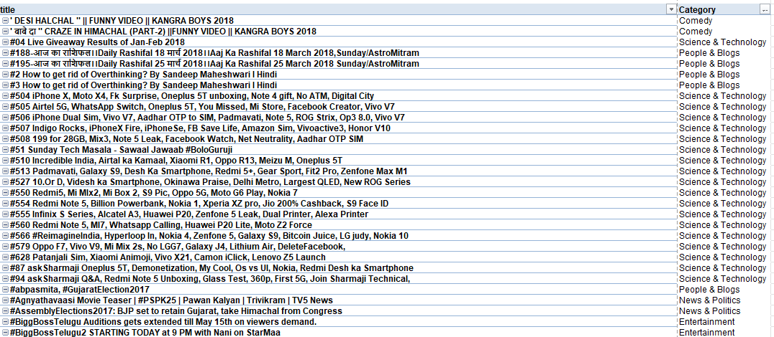
Question 4
Insights
Using pivot category with videos are calculated
Category is found by using xlookup
Steps
Use X lookup to find the category
Using filter and pivot to find category wise channels
Formula
=FILTER('YouTube data'!$D$2:$D$16308,'YouTube data'!$E$2:$E$16308='Task 4'!A2)
=XLOOKUP(A2,Category!$A$1:$A$33,Category!$B$1:$B$33,"N/A")

Slide 6
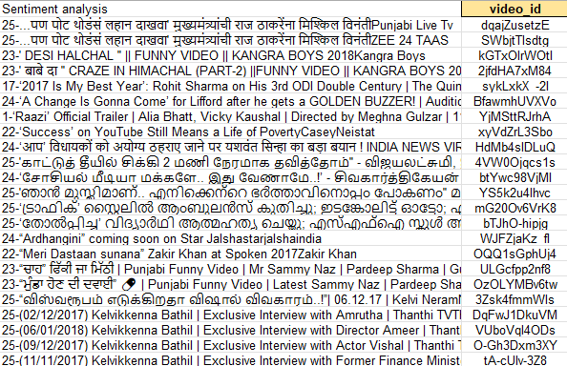
Question 5
Inference
Key values are created
Steps
Textjoin
concat
Formula
=TEXTJOIN("-",TRUE,'YouTube data'!E2,CONCAT('YouTube data'!C2:D2))

Slide 7
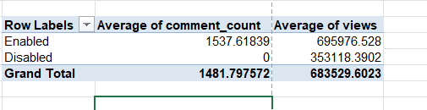
Question 6
Inference
Videos is comments enabled performs good
Steps
Took comment disabled date’
Formula
Used PIVOT

Slide 8
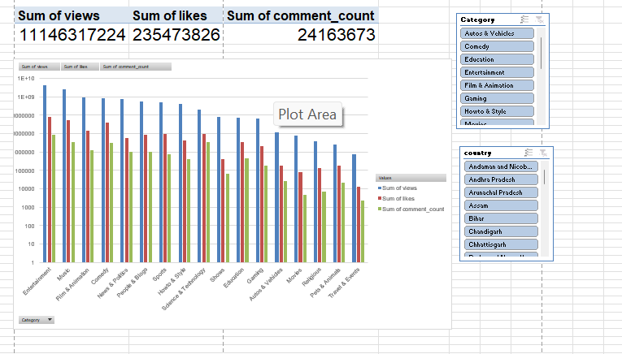
Question 7
Inference
Steps
Formula

Slide 9
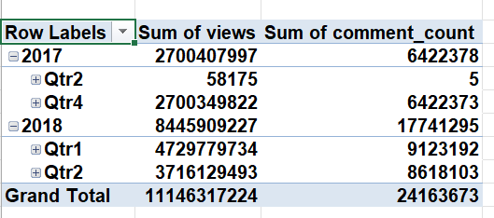
Question 8
Inference
Steps
Formula

Slide 10
Question 9
Inference
Refer excel
Steps
Formula

Slide 11
Question 10
Inference
Refer excel
Steps
Formula

Slide 12
Question 11
Inference
Refer excel
Steps
Formula

Slide 13
Question 12
Inference
Refer excel
Steps
Formula

Slide 14
Question 13
Inference
Refer excel
Steps
Formula

Slide 15
Question 14
Inference
Refer excel
Steps
Formula

Slide 16
Question 15
Inference
Refer excel
Steps
Formula

Slide 17
Question 16
Inference
Refer excel
Steps
Formula

Slide 18
Question 17
Inference
Refer excel
Steps
Formula

Slide 19
Question 18
Inference
Refer excel
Steps
Formula

Slide 20
Question 19
Inference
Refer excel
Steps
Formula

Slide 21
Question 20
Inference
Refer excel
Steps
Formula

